Slide 1
Parent
Orientation
2018-2019

Slide 2
Mission
ASU Preparatory Academy is an innovative K-12 charter school where teachers, students and families share the same goal – college graduation. Our mission is to provide premium environments for learning, helping all students become innovative leaders and problem solvers who are prepared for success in college and their preferred careers.
Cambridge Curriculum
AZ College & Career Ready Standards
Academics | Partnership | Leadership | Innovation

Slide 3
Administration
Principal:
Claudia Mendoza
claudia.mendoza@asu.edu
Dean of Students/Athletic Director:
Amy Kochis
amy.kochis@asu.edu
Dean of Students/Counselor:
Erin Nielsen
erin.nielsen.1@asu.edu

Slide 4
Curriculum Night
We hope you will join us for our scheduled Curriculum Night(s). Teachers will share the academic curriculum students will learn this year. You will see and understand your child's school day and also the importance of our school-home partnership. We look forward to seeing you here!
K - 5: Tuesday, Aug. 7 - 5:30 p.m.
6 - 8: Thursday, Aug. 9 - 5:30 p.m.

Slide 5
Parent information about ASU Prep STEM, PK-8
Lunch
Classy Touch Catering
Monthly Lunch menu
OR
Bring lunch from home
Birthday Celebrations
Not celebrated with treats.
We Encourage:
parent lunch w/ student
donate a book to class in their honor
come read a book
Party invitations can not be passed out at school.
Class Parties
All food must be store-bought and include nutritional labels (food allergies.)
No siblings!
Reporting Student Absences
480-727-5709
Also inform teacher by email or phone!
Notes:
All hot lunch orders will be made online, directly with our new hot lunch provider, Classy Touch Catering- for more information and step by step directions on creating an account please visit them at our resource fair!
If a parent wants to bring in “little gifts” (pencils etc. ) They will need to bring in enough for the entire class!
5

Slide 6
Birthday Lunch
Parents are welcome to have lunch with their children on their birthday.
Please note change:
This year we ask that parent(s) sit with their children in our cafeteria or designated lunchroom.

Slide 7
Parent information about ASU Prep STEM, PK-8
Uniforms
Maroon Shirt
collared shirt (any retail store!)
ASU Prep optional
Beige Bottom
Shorts (no cargo style)
Pants
Skorts (girls)
Skirts
Parent Communication
Teacher websites
updated weekly
Emails from:
Grade-level
Front office
School Newsletter
weekly via email
Volunteer Hours
Encouraged but NOT mandatory
30 hours
- Automatically tracked through front office sign-in
Notes:
Remind parents to check their email regularly
Remind them to confirm with you that they are getting your emails….
7

Slide 8
Parent Communication
School Messenger
Opt- In from your mobile phone now!
Send ”Y” or “Yes”
to 67587
* Our goal is 100% family participation!

Slide 9
Dress Code
Preschool - Grade Eight:
The school uniform is a maroon polo top and khaki bottoms.
On ASU Spirit Fridays, students may choose to wear the school uniform, a gold polo or any ASU T-shirt and khaki bottoms.
Notes:
DRESS CODE will be strictly enforced!
9

Slide 10
Dress Code
Tops:
Maroon polo-
Solid color collared polo shirts with buttons
(ASU Prep logo accepted but is not mandatory)
Shirts may be short or long sleeved
Must be size appropriate
Must be tucked in at all times!

Slide 11
Dress Code
Bottoms:
Khaki
Pants, shorts, skorts or skirts
no cargo shorts, no logos or writing accepted
Must be size appropriate
Hemlines for girl’s shorts, skorts and skirts must extend beyond the out-stretched fingers as the arm is relaxed against the side of the body
Shorts under skirts highly recommended!!
No jeans or denim may be worn except on designated non-uniform days

Slide 12
Dress Code
Shoes:
For the safety of your child.
ONLY athletic shoes with non-slip sole are allowed
and they must be worn with socks or tights!
Socks: ONLY white, black or maroon

Slide 13
Dress Code
Outerwear:
ONLY white, black or maroon turtlenecks/undershirts may be worn underneath the polo style shirt
ONLY white, black or maroon tights/leggings-
Only SOLID white, black or maroon jackets, sweatshirts or sweaters (no logos, except ASU accepted) may be worn over a uniform shirt with the collar showing.
All other jackets must be taken off while indoors!
Notes:
Yes- hoodies are allowed BUT hood must remain off while indoors!!

Slide 14
Dress Code
Interpretation of Dress Code
Any interpretation of the dress code will be determined solely by the administration at ASU Preparatory Academy including the definitions of “interference with the educational process” and “items that present a safety hazard.” Violations of the dress code will have assigned consequences outlined in the Student Code of Conduct and at the discretion of the administration.
Mascot: Sun Devil
School Colors: Maroon and Gold

Slide 15
Drop-off / Pick-up Procedure
School starts at 8:15am and dismissal is at 3:15pm
Students may be dropped off between 7:45 - 8:15am
We strongly encourage all families to drop-off and pick-up using the designated car line!
Kindergarten parents will be allowed to walk their children to class for the first 2 days of school. On the third day parents will say goodbye to their children before reaching the playground area and will not be permitted on the playground.
Grades 1st thru 8th parents will be allowed to walk their children to their classroom line on the playground on the first day of school ONLY. However, if you are a returning family and know the routine, we encourage you to use car drop-off– even on the first day!
After the first day, for the safety of our students:
Parents are not allowed on the playground.
Parents are not allowed to walk their child to their classroom.
Notes:
****** School playground gates do not open until 7:45am therefore, STUDENTS DROPPED OFF BEFORE 7:45 WILL BE UNSUPERVISED!!!

Slide 16
Drop-off / Pick-up Procedure
Please follow this Traffic Flow Map when dropping off and picking up students!

Slide 17
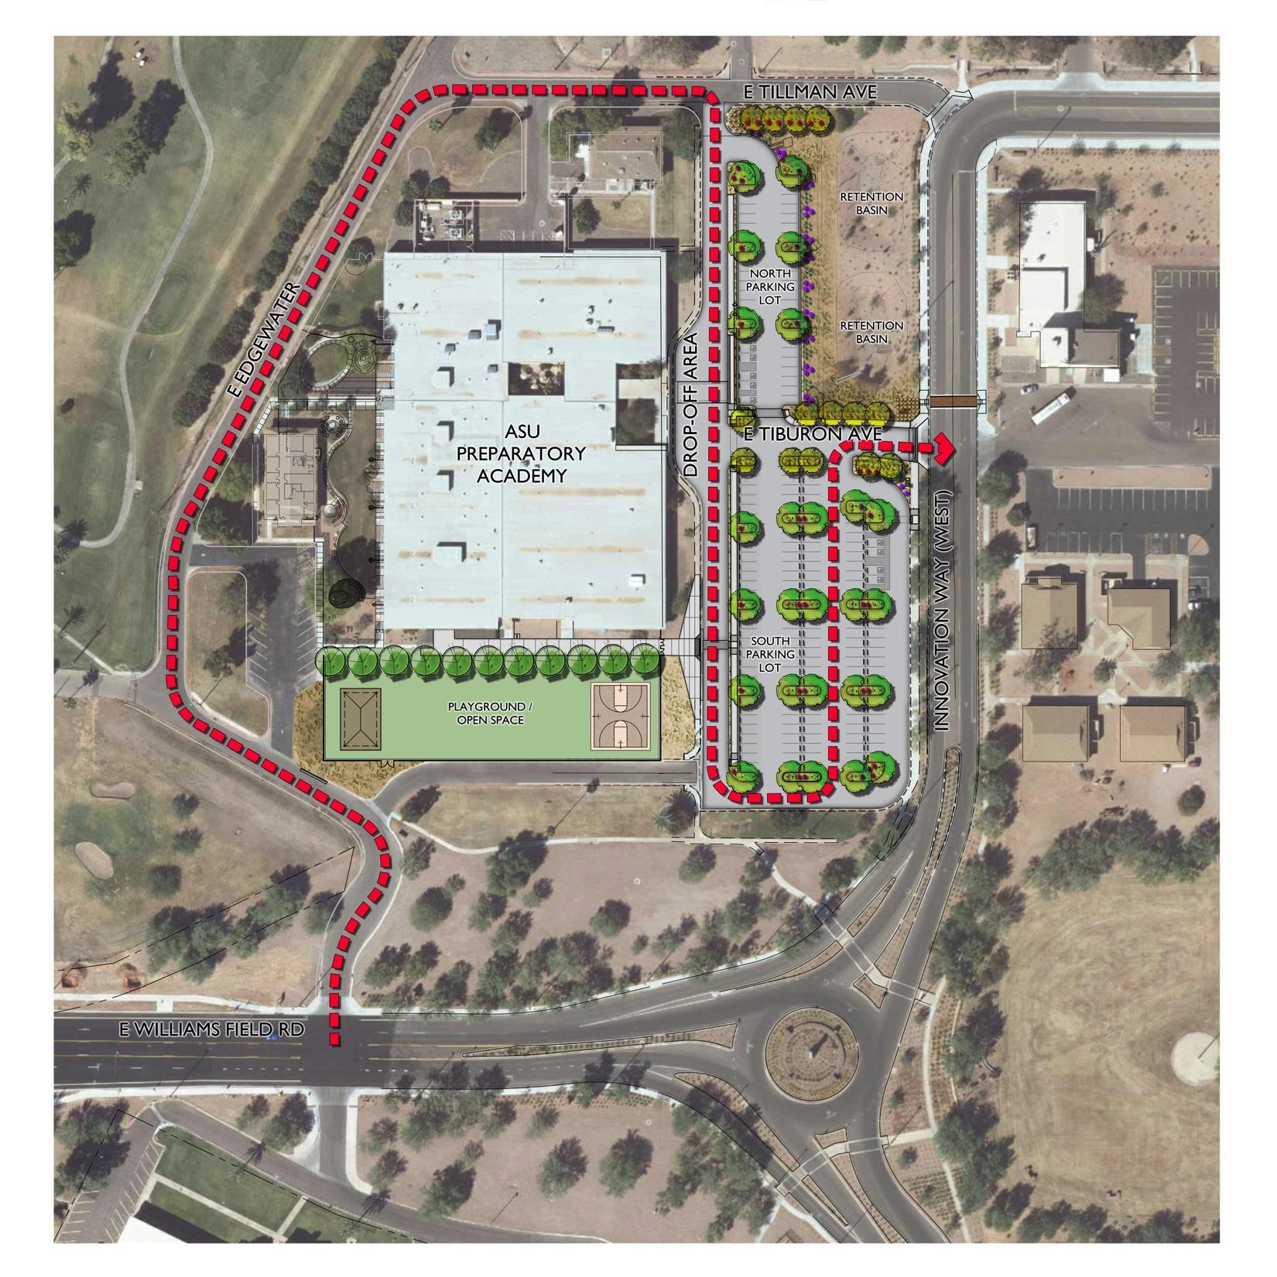

Slide 18
Important!
Please drop your student(s) off as you enter the ‘drop-off ’ curb in front of the school and students will walk up the sidewalk. This allows for a more efficient process. THANK YOU!!
Please keep your name plate displayed the entire time. This helps our staff with locating your student and getting him/her to your car faster!
Drop-off: Please be sure your student is ready to hop off the car as you arrive at curb. Make sure shoelaces are tied, their backpacks are ready to grab & etc.
If you choose to drop off before 7:45am,this means your student will be unsupervised outside our school gates.
Notes:
*** Please stress last bullet point!

Slide 19
Drop-off / Pick-up Procedure
East Parking Lot:
Parking in the Parking Lot without a parking permit for longer than 5-7 minutes may result in a citation from the ASU Parking Department, please park at your own risk!
For the safety of your student:
If you choose to park, you MUST WALK your student on or off campus by using the CROSS WALK provided.

Slide 20
Drop-off / Pick-up Procedure
Small West Lot:
ONLY Preschool Parents will be allowed to use this lot as they must sign their students in and out every day.
FYI: Daycare Buses
For pick-up, vans will be allowed to enter line off of Tilman just north of school.
They pick up a various schools.

Slide 21
Discipline
School Rules:
Respect Yourself
Respect Others
Respect This Place

Slide 22
Discipline K – 5
Pink Ticket:
If your student receives a pink ticket, he/she made a bad choice at school. Pink tickets must be signed by you and returned to school the following day.
*You will also receive either a phone call or an email from the teacher.
Please refer to our student handbook & teacher’s Weebly sites
for more information on disciplinary action.
Notes:
22

Slide 23
Discipline 6 – 8
Agenda Line:
If there is a line drawn across your student’s agenda he or she has made a bad choice, and will be assigned a lunch detention.
*You will also receive either a phone call or an email from the teacher.
Please refer to our student handbook & teacher’s Weebly sites
for more information on disciplinary action.

Slide 24
Zero tolerance for Bullying
ASU Prep is committed to keeping our school bully-free.
If we are not aware of potential bully situations that are on-going we can’t investigate and handle appropriately so we ask that you notify us right away.
Who to Notify?:
Teacher
Dean of Students:
Erin Nielsen or Amy Kochis
Principal – Claudia Mendoza

Slide 25
ASU Prep’s Anti-Bullying
ASU Prep’s Anti-bullying Pact
We will not bully others.
We will help students who are bullied.
We will include students who are left out.
If we know that somebody is being bullied, we will tell an adult at school and an adult at home.
We will respect ourselves, others and this place.
Olweus Anti-Bullying Program
School Kick-off: Monday, August 6
Parent Information will be available at each designated Curriculum Night.

Slide 26
Olweus Think Sheet
If your student is sent home with a ‘Think Sheet’ it is because they displayed bullying behavior toward another student. This sheet needs to be signed by a parent and returned to the homeroom or Foundations teacher the next day.
You will be called or emailed by the reporting teacher giving you more details about the behavior and the consequence given to your student.
Please refer to our student handbook for more information on disciplinary action.

Slide 27
Character Education Program
The Leader in Me
Be Proactive
Begin with the End in Mind
Put First Things First
Think Win-Win
Seek First to Understand, Then to Be Understood
Synergize
Sharpen the Saw

Slide 28
ILP Parent-Teacher Conferences
4 times per school year
Dates:
July 26th- Meet the Teacher/Open House & Resource Fair
October 9th , 10th
January 8th , 9th
March 14th , 15th
Notes:
Check dates!

Slide 29
K-4 Specials
Art
Music
PE
Español
STEM

Slide 30
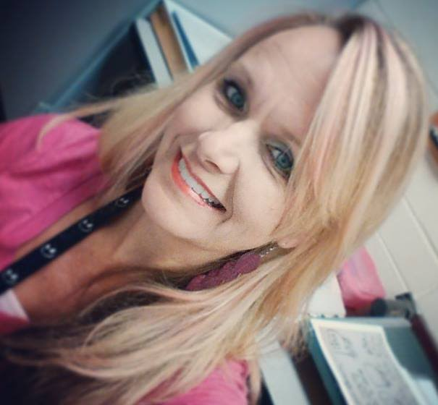
K-8 Art Mrs. Olsen
I am thrilled to continue the Art Program at ASU Prep this year.
Students will be learning a variety of techniques in drawing, painting, sculpture and mixed media.
Please visit my website:
solsenasuprep.weebly.com
Follow us on Instagram @asu.prep.art
Feel free to contact me with questions or concerns.
Stormy.Olsen@asu.edu
(480) 727-5844

Slide 31
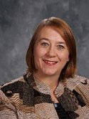
K- 4 Music, Mrs. Jernigan
Welcome to the 2018-2019 School Year!
This will be an exciting year filled with singing, movement, dance and playing instruments with music from around the world.
I will communicate with you through my school website,
emails, phone calls and notes home.
susan.jernigan@asu.edu
sjerniganasuprep.weebly.com
(480) 727-5846
I am looking forward to seeing everyone!
PS. I have also been known to play with LEGO Robots ☺ and Harps!

Slide 32
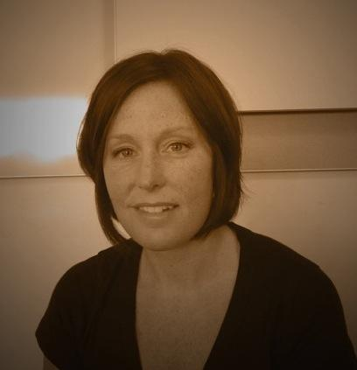
K-4 Physical Education Coach Fahey
P.E. Requirements
Every child will need to wear closed toe tennis shoes for P.E.
Water bottles are encouraged on P.E. days. Please make sure they are labeled with your child’s name
Hats may be worn during P.E. as long as they are not distracting to the class
P.E. is located in room 102 this year. Stop by and say hi sometime!
Contact Information
I am looking for volunteers to help throughout the year. Please contact me via:
Email: christie.fahey@asu.edu
Website:christiefaheyasuprep.weebly.com
Phone:480.727.5716
I am looking forward to a phenomenal year!
-Coach Fahey

Slide 33
Español K-4: Sra. Lawrence
I will communicate with you through my school website, emails, phone calls, and notes home.
Volunteers are welcomed and encouraged! Please see my contact information below:
Email: gegonza4@asu.edu
Website: glawrenceasuprep.weebly.com
Office: (480) 727-5700
Direct: (480) 727-5859
Amor, Paz, y Español,
G. Lawrence

Slide 34
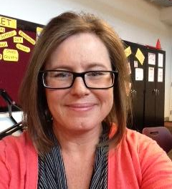
K-4 STEM, Mrs. Houseman
This year in the STEM Lab your child will work collaboratively with their peers to solve real world problems incorporating science, technology, engineering and math.
All communication regarding classwork and discipline will be handled through my Weebly Website and phone calls home. Volunteers are welcomed and encouraged! Please see my contact information below:
Danielle.Houseman@asu.edu
dhousemanasuprep.weebly.com
(480) 727-5747
I am looking forward to working with and meeting all families at ASU Prep!

Slide 35
5-8 Specials
Art
Music
PE
Español

Slide 36
5th STEM Mrs. Obert
Angie.Obert@asu.edu
aobertasuprep.weebly.com
(480) 727-5700

Slide 37
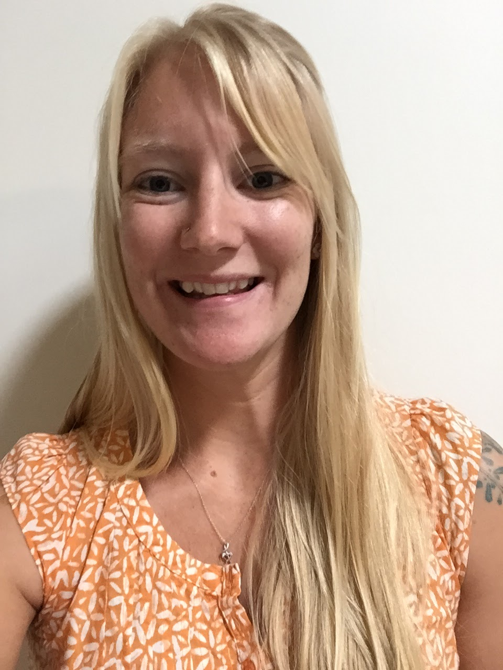
5-8 Grade Music
Parent communication will be made through website, email, and phone calls.
Weebly: mkillianasuprep.weebly.com
Email: miranda.killian@asu.edu
Feel free to contact me at any time regarding issues or concerns within the classroom.
Classroom expectation
Pencils are required to bring to class everyday. (Everything else I will supply or contact you in advanced)
Music is a very hands on activity and participation is a must!
Positive attitude and readiness to learn and appreciate music of various cultures and genres.
I am ecstatic to be part of the ASU Poly team. I love music and have studied it for many years. My goal for each student is for them to find joy in a new instrument or genre by the end of the school year. I look forward to working with you and your child to achieve this goal.

Slide 38
I am very accessible to all families:
* bbrownasuprep.weebly.com
* bbrown9@asu.edu
* 480-727-5361
What to bring on PE Days:
Every student should wear closed toes shoes. If they are not wearing the proper shoes, they will not be able to participate.
Students may wear hats and sunglasses outside during PE.
Bring a positive attitude and willingness to have fun!

Slide 39
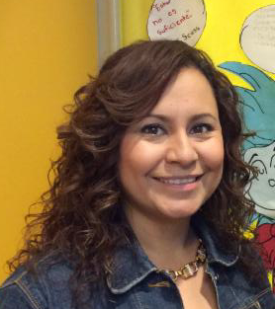
Bienvenidos a Español 5-8
All communication regarding classroom activities and events will be handled through school website.
All communication regarding classroom behavior and concerns with student progress will be handled through email or phone call home.
Contact information:
Email: christina.caro@asu.edu
Weebly:http://mcaroasuprep.weebly.com/
Direct:480-727-5356
I am very excited to be working with all of you this year!
This will be our best year yet!!
Un abrazo,
Sra. Caro

Slide 40
From our Health Office
Immunization:
If you were notified by our health assistant, Mrs. G that your child is not current on his/her immunization, please stop by and see her in the health office.
If we do not have a current vaccination record on file by Monday, August 6th your child will not be allowed to return to school until he/she is current.

Slide 41
From our Health Office
Immunization:
Attention 6th Grade families: If your student has turned 11, please turn in a copy of their Tdap and Meningitis vaccines to the health office by the first day of school!!
Health Assistant Contact Information:
Mrs. Lori Gutierrez
480-727-5708
lagutie3@asu.edu

Slide 42
From our Front Office
Power School Account:
Attention all PK-8th Grade families: If you do not have a Power School account, please see the Power School table at the resource fair. We strongly encourage all families to visit the ASU Prep Academy Online Payment Portal link: http://asuprep.intouchreceipting.com/signin.aspx
*You will have the ability to make online payments and set up recurring payments for kindergarten and preschool tuition.

Slide 43
www.asuprepathletics.com
All 5th – 8th graders may participate in ASU Prep Athletics
FALL SPORTS:
tryouts start August 6th
Fall Cheer
Cross Country
Girls Volleyball
Boys Flag Football
Swimming
Spring Sports:
Girls Basketball
Boys Baseball
Track & Field
Coed Soccer
Winter Sports:
Girls Softball
Boys Basketball
Wrestling
Winter Cheer
Notes:
BB wants to make changles!!

Slide 44
Ho
Homework Club 6th-8th only
Student and Parent must sign homework club contract and walking permission slip.
Hours: 3:30 – 4:30pm
All students will be released at 4:30!
Notification:
After 4:30pm students will be allowed to wait in front of the school but will be unsupervised.
Notes:
Due to having a “walking” permission slip on file, PLEASE BE AWARE that students will be released even if parent has not arrived to pick them up and they will be waiting out front without adult supervision.

Slide 45
Ho
Club Poly PK-5
Before and after school care:
AM : starting at 6:15am
PM: 3:15-6:00pm
*See them at resource fair for more information regarding registration and fees.

Slide 46
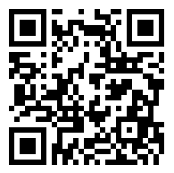
Add Your Summer Photos to Our padlet page
Scan the QR code with a QR code scanner on your phone.
Click the + sign then the ⬇ to upload your picture.

Slide 47
Family Resource Fair
Please visit our family resource fair being held in our Multipurpose Room!

Slide 48
Family Resource Fair
Polo Shirt Sales
Uniform Swap
PTSO
Lunch Program- Class Touch Catering
National School Lunch Program Forms
School Health Assistant – in Health Office
5th-8th Athletics Program
6th-8th Schedule Distribution

Slide 49
Family Resource Fair
Club Poly- Before/After School Care
Drop-off/ Pick-up Procedure
Family Car Name Plate Pick-up
Lego Robotics Club- 5th/6th, 7th/8th
Student Handbooks – release form
Power School Login Information (if needed)
Leader In Me
Scavenger Hunt Prize Pick up

Slide 50
Forms to be Turned In
National School Lunch Program Form
Handbook Release Forms
Walking Permission Slip for 5th-8th

